Slide 1
Semantic Information Modeling for Federation
SIMF
Cory Casanave

Slide 2
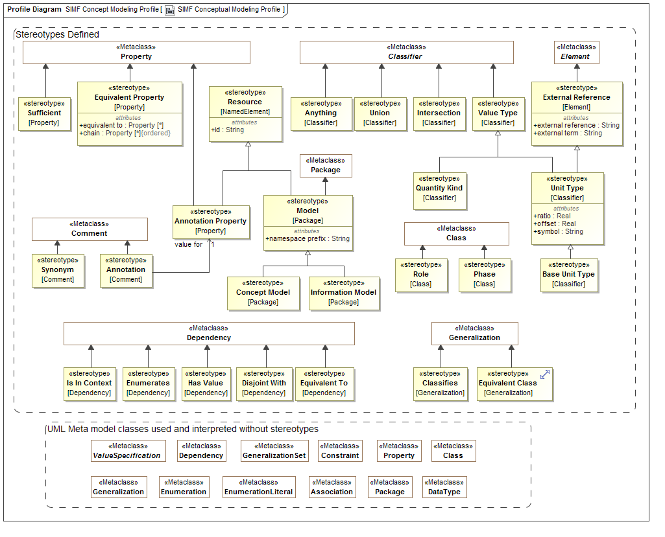
Conceptual Model Profile

Slide 3
SIMF Conceptual Modeling Profile
Jim Logan

Slide 4
Overview
Uses “normal” UML with business-facing terms
Takes advantage of a few “loose” areas of UML
Unnamed redefining properties
Unnamed subsetting properties
Adds some extensions (next slide)

Slide 5
Extension to UML
Class extensions:
«Anything»
«Union»
«Intersection»
«Equivalent Class»
«Role»
«Phase»
Comment extension: «Annotation» {annotation property = annotation property}
Property extensions:
«Annotation Property»
«Equivalent Property»
{equivalent property = property}
{chain = property, property}
«Sufficient»
«Value Type»
«Facet Of» (Examples still say «Classifies»)

Slide 6
Simple Classes and Properties (Model)

Slide 7
Simple Classes and Properties (MM Instances)

Slide 8
Simple Classes and Properties (OWL)
Ontology(<http://example.com/SIMF/Company>
Declaration(Class(:Employee))
Declaration(Class(:Employer))
Declaration(ObjectProperty(:employedBy))
Declaration(ObjectProperty(:employs))
SubClassOf(:Employee ObjectIntersectionOf(
ObjectMaxCardinality(1 :employedBy :Employer)
ObjectMinCardinality(1 :employedBy :Employer))
)
InverseObjectProperties(:employedBy :employs)
ObjectPropertyDomain(:employedBy :Employee)
ObjectPropertyRange(:employedBy :Employer)
ObjectPropertyDomain(:employs :Employer)
ObjectPropertyRange(:employs :Employee)
AnnotationAssertion(rdfs:label :Employee "Employee"@en)
AnnotationAssertion(rdfs:label :Employer "Employer"@en)
AnnotationAssertion(rdfs:label :employedBy "employed by"@en)
AnnotationAssertion(rdfs:label :employs "employs"@en)
)
Prefixes elided for readability.
Will elide most annotations for remaining slides.

Slide 9
Global Properties (Model)

Slide 10
Global Properties (MM Instances)

Slide 11
Global Properties (OWL)
Ontology(<http://example.com/SIMF/Relations>
Import(<http://example.com/SIMF/DutiesAndResponsibilities#>)
Declaration(Class(<http://example.com/SIMF/DutiesAndResponsibilities#Duty>))
Declaration(ObjectProperty(:hasResponsibility))
Declaration(ObjectProperty(:isConferredBy))
Declaration(ObjectProperty(:isConferredOn))
ObjectPropertyRange(:hasResponsibility
<http://example.com/SIMF/DutiesAndResponsibilities#Duty>)
)

Slide 12
Incomplete and Disjoint (Model)

Slide 13
Incomplete and Disjoint (MM Instances)

Slide 14
Incomplete and Disjoint (OWL)
Ontology(<http://example.com/ontology/Animals>
Declaration(Class(:Animal))
Declaration(Class(:Cat))
Declaration(Class(:Dog))
SubClassOf(:Cat :Animal)
DisjointClasses(:Cat :Dog)
SubClassOf(:Dog :Animal)
)

Slide 15
Incomplete and Overlapping (Model)

Slide 16
Incomplete and Overlapping (MM Instances)

Slide 17
Incomplete and Overlapping (OWL)
Ontology(<http://example.com/SIMF/Manufacturer1>
Declaration(Class(:CarManufacturer))
Declaration(Class(:Manufacturer))
Declaration(Class(:WindshieldManufacturer))
SubClassOf(:CarManufacturer :Manufacturer)
SubClassOf(:WindshieldManufacturer :Manufacturer)
)

Slide 18
Complete and Disjoint (Model)

Slide 19
Complete and Disjoint (MM Instances)

Slide 20
Complete and Disjoint (OWL)
Ontology(<http://example.com/SIMF/Manufacturer2>
Declaration(Class(:CarManufacturer))
Declaration(Class(:Manufacturer))
Declaration(Class(:WindshieldManufacturer))
DisjointClasses(:CarManufacturer :WindshieldManufacturer)
SubClassOf(:CarManufacturer :Manufacturer)
SubClassOf(:WindshieldManufacturer :Manufacturer)
EquivalentClasses(:Manufacturer ObjectUnionOf(:WindshieldManufacturer :CarManufacturer))
)

Slide 21
Universal Quantification (Model)

Slide 22
Universal Quantification (MM Instances)

Slide 23
Universal Quantification (OWL)
Ontology(<http://example.com/SIMF/Pets>
Declaration(Class(:Dog))
Declaration(Class(:DogOwner))
Declaration(Class(:Person))
Declaration(Class(:Pet))
Declaration(ObjectProperty(:has))
SubClassOf(:Dog :Pet)
SubClassOf(:DogOwner :Person)
EquivalentClasses(
:DogOwner
ObjectIntersectionOf(
ObjectMinCardinality(1 :has :Dog) ObjectAllValuesFrom(:has :Dog)
)
)
ObjectPropertyDomain(:has :Person)
ObjectPropertyRange(:has :Pet)
)

Slide 24
Existential Quantification and Union (Model)

Slide 25
Existential Quantification and Union (MM Instances)

Slide 26
Existential Quantification and Union (OWL)
Ontology(<http://example.com/SIMF/LegalCapacities>
Import(<http://example.com/SIMF/Agents#>)
Import(<http://example.com/SIMF/Relations#>)
Import(<http://example.com/SIMF/LegalCore#>)
Import(<http://example.com/SIMF/Contracts#>)
Declaration(Class(:LegalCapacity))
Declaration(Class(:LegalConstruct))
SubClassOf(:LegalCapacity
ObjectMinCardinality(1 :isCapacityOf
<http://example.com/SIMF/Agents#AutonomousAgent>
)
)
SubClassOf(:LegalConstruct
ObjectSomeValuesFrom(
<http://example.com/SIMF/Relations#isConferredBy>
ObjectUnionOf(
<http://example.com/SIMF/Contracts#Contract>
<http://example.com/SIMF/LegalCore#Constitution>
<http://example.com/SIMF/LegalCore#Law>
)
)
)
Declaration(ObjectProperty(<http://example.com/SIMF/Agents#hasCapacity>))
Declaration(ObjectProperty(<http://example.com/SIMF/Relations#isConferredBy>))
Declaration(ObjectProperty(<http://example.com/SIMF/Relations#isConferredOn>))
Declaration(ObjectProperty(:isCapacityOf))
InverseObjectProperties(<http://example.com/SIMF/Agents#hasCapacity> :isCapacityOf)
SubObjectPropertyOf(:isCapacityOf <http://example.com/SIMF/Relations#isConferredOn>)
ObjectPropertyDomain(:isCapacityOf :LegalCapacity)
ObjectPropertyRange(:isCapacityOf <http://example.com/SIMF/Agents#AutonomousAgent>)
)

